Slide 1
Machine Learning with Golang
Ephraim Berkovitch, Jan 2021 / ZipRecruiter

Slide 2
Agenda
Why ML in Go? Use cases for programming ML/DL with Go; pros and cons
Go ML environment
Data Wrangling Library gota
Scientific Library gonum
Plotting libraries
Algorithms
Supervised Learning
Unsupervised Learning
Using pre-trained models
Deploying ML applications

Slide 3
Accompanying Materials
https://github.com/ephraimberkovitch/golang_ml
http://www.cs.jhu.edu/~mdredze/datasets/sentiment/processed_acl.tar.gz

Slide 4
Why ML in Go – in all cases
Easy to learn and on-board new developers
Fast build time
Good performance at run-time
Great concurrency support
Excellent standard library
Type safety
Easy-to-read, standardized code with gofmt
Forced error handling to minimize unforeseen exceptions
Explicit, clear dependency management
Easy to adapt architecture as projects grow

Slide 5
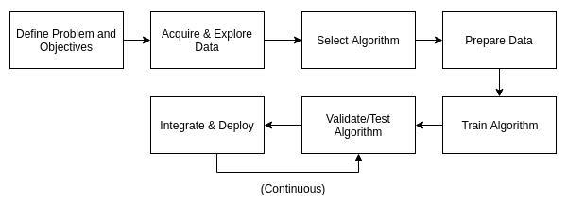
Why consider using ML in Go
Go mature eco-system
Strict application flow
Proper software engineering

Slide 6
Jupyter Kernel for Go
gophernotes
https://github.com/gopherdata/gophernotes - backend - interpreter
alternatives - lgo (https://github.com/yunabe/lgo) - backend - official compiler, elder versions
docker run -it -p 8888:8888 -v $(pwd):/usr/share/notebooks gopherdata/gophernotes:latest-ds

Slide 7
Data Wrangling Library - gota
Counterpart of Python’s pandas
https://github.com/go-gota/gota
Load CSV
Pre-processing data
Re-name, remove columns
Filter out irrelevant data
Training / validation data
Dataframe.Subset
Encoding data with categorical values

Slide 8
Scientific and Plotting Library - gonum + gonum/plot
Counterpart of Python’s numpy
https://www.gonum.org/ - GoNum
set of packages designed to make writing numerical and scientific algorithms productive, performant, and scalable

Slide 9
Supervised Algorithms
Classification
Regression

Slide 10
Unsupervised Algorithms
Clustering
PCA

Slide 11
Using pre-trained modules
TensorFlow for Go is not mature yet
https://www.tensorflow.org/install/lang_go - The TensorFlow Go API is not covered by the TensorFlow API stability guarantees
There is a Gorgonia framework, written completely in Go - low-level, like Theano, but has higher goals like Tensorflow

Slide 12
Using Python models
When to adopt a polyglot approach
Polyglot – use Python-only libraries like Keras in Python, reduce amount of code and in some cases, better performance, multi-team cooperation, leverage pre-existing models; more complex problems, deep learning, computer vision
Go-only - easier to maintain, less dependencies, less complexities in component interactions; when existing Go libraries offer what you need

Slide 13
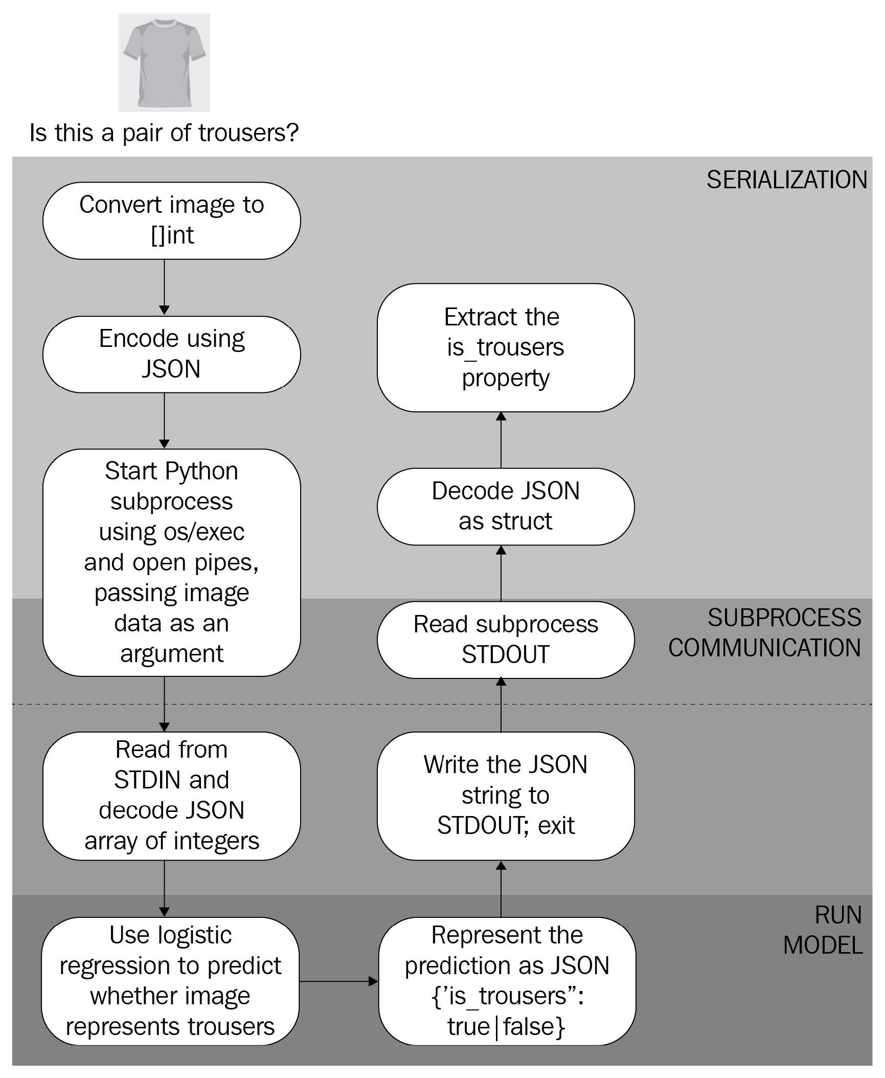
Invoke Python model using os/exec
Model is on the same machine
use command-line arguments to pass inputs to the model and read the model's prediction from standard output (STDOUT)
JSON for data exchange
Load dataset to dataframe
stdout, err := cmd.StdoutPipe()
b, err = InvokeAndWait("model.py", "predict", string(b))
Cons – start a new Python process to handle every
request, coupling with Python
Pros – small effort

Slide 14
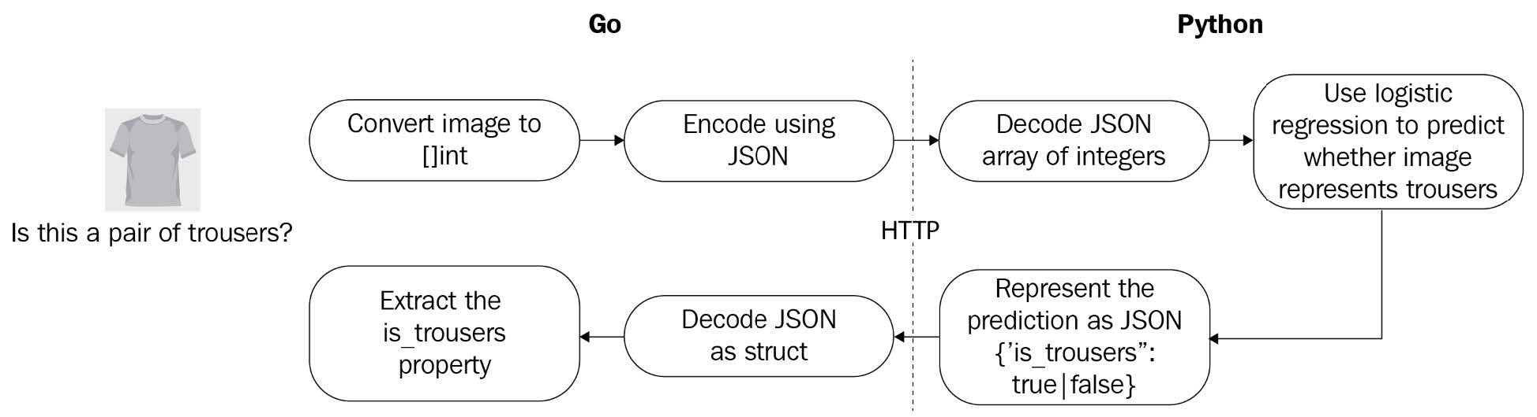
Invoke Python models using HTTP
Model is running as a service on different machine

Slide 15
Go bindings of TensorFlow
Install TensorFlow as a docker
Import pre-trained TensorFlow model
savedModel, err := tf.LoadSavedModel("./saved_model", []string{"serve"}, nil)
if err != nil {
log.Fatalf("failed to load model: %v", err)
}

Slide 16
Deployment

Slide 17
When and where to use ML
Typical stages in ML project

Slide 18
Pure Go ML frameworks
Gorgonia – DL
Prose - NLP

Slide 19
References
Michael Bironneau, Toby Coleman, Machine Learning with Go Quick Start Guide, Packt Publishing, 2019
https://tech.travelaudience.com/training-tensorflow-models-in-python-and-serving-with-go-1b2a9386b0ff
https://towardsdatascience.com/why-we-deploy-machine-learning-models-with-go-not-python-a4e35ec16deb
https://github.com/gorgonia/gorgonia
https://github.com/jdkato/prose

